Slide 1
AI Revolution:
Impact Across Different Industries
Rujia (Jade) Yuan

Slide 2
Table of contents
01
02
07
08
03
04
Executive
Summary
Topic
Detection
Methodology
& Source Data
Overview
Article
Clean-Up & Filtering
05
06
Sentiment
Analysis
Entity Identification
Actionable Recommendation
Targeted Sentiment Identification ​

Slide 3
Executive Summary
This project aims to discern the impact of AI on various occupational tasks and job sectors by analyzing a wealth of unstructured text, enabling us to offer strategic recommendations. Our extensive dataset spans multiple industries, such as technology, finance, healthcare, media, and education, with a focus on AI's industry-specific influences.
Key drivers of successful AI initiatives include effective cloud solutions, enhanced customer interaction via NLP tools like ChatGPT, insightful financial analytics, robust security protocols, and AI's transformative role in healthcare and education. Conversely, AI endeavors often stumble due to heightened public scrutiny, ethical quandaries, economic volatility, unpredictable outcomes in algorithmic trading, legal challenges, and the propagation of digital misinformation. These contrasting factors delineate the intricate balance between AI's potential and the prudent management of its multifaceted implications.
Sentiment analysis reveals a generally positive outlook on AI's role across these sectors. The prevailing sentiment towards AI remains more positive than negative, reflecting confidence in its potential to transform industries and enhance human productivity.
To propel the evolution of AI, cross-industry collaborations are vital, particularly between established tech companies and sector-specific entities. Educational reforms focused on AI utilization and healthcare continues investing funding for AI development are imperative. Furthermore, it is essential for legislative bodies to formulate dynamic regulatory frameworks that address AI's ethical, legal, and societal impacts comprehensively.
In the realm of entity identification, tech companies’ CEOs and political leaders frequently emerge due to their close ties with AI progression and regulatory discourse. Targeted sentiment identification reveals that investment in data science initiatives by tech, finance, healthcare, media, and education companies, is crucial for enhancing operational efficiency and fostering cutting-edge applications. However, AI cannot supplant roles that require human insight and domain expertise, like for healthcare field which needs doctors and nurses carefully checking, and for financial market, which has unpredictability that AI may not catch. As such, education on AI's judicious application, meticulous testing, and robust regulation are paramount in the deployment of AI solutions.

Slide 4
Methodology & Source Data Overview
Article Clean-up
& Filtering
Topic
Detection
Sentiment Analysis
Implemented topic detection via LDA in Gensim for optimal topic number selection, enhanced with K-train for summarization, and supplemented by sentiment analysis to gauge topic-specific sentiment orientation
Employed a hybrid sentiment analysis approach, utilizing TextBlob for initial assessments and a pre-trained transformer model from Hugging Face for advanced classification
Refined and distilled relevant content through targeted removal of extraneous elements and keyword-specific filtration
Entity
Identification
Targeted sentiment identification
Utilized spaCy package to label organization, person, location and GPE
Employed spaCy for entity labeling combined with sentiment analysis to distill positive and negative sentiments, using word clouds to highlight prevalent AI technologies and their associated sentiments

Slide 5
Methodology & Source Data Overview
The original dataset contains 199,677 unstructured news articles as rows along with 5 additional information columns: URL, date, language, title, and text.
The data date range is from 2020-01 to 2023-07.
The articles’ fields include healthcare, finance, media .etc.
No NA value in the dataset.
After data cleaning & filtering, the filtered dataset contains 120,452 rows along with 11 columns, including the processed text step by step, and removed text as comparisons. In the end, we have a final dataset with 18 columns, containing sentiments, polarity. etc.

Slide 6
Article clean-up and filtering
1. Basic Text Cleaning
2: Advanced Text Processing
3. Sentence Splitting and Trimming
4. Filtering
Irrelevant Endings
5. Keyword-Based Filtering
6. Final Data Preparation
Remove special characters: [\t, \r, \xa0, \xad, ', \]
Strip URLs and emails.
Replace newline characters (\n) with spaces.
Keep only letters, numbers, and basic punctuation.
Remove backslashes and HTML tags.
Trim leading whitespaces.
Split text into sentences based on punctuation ([.!?;,]).
Discard sentences over a certain length (400 characters).
Remove ending contents after phrases like ['About Us:', 'Related Articles', 'Sponsored Content:', 'More Stories’..].
Retain articles containing keywords: ['machine learning', 'artificial intelligence', 'data science’..]
Ensure text is in English.
Concatenate the filtered sentences into a single string.
Normalize spaces (replace multiple spaces with a single space).

Slide 7
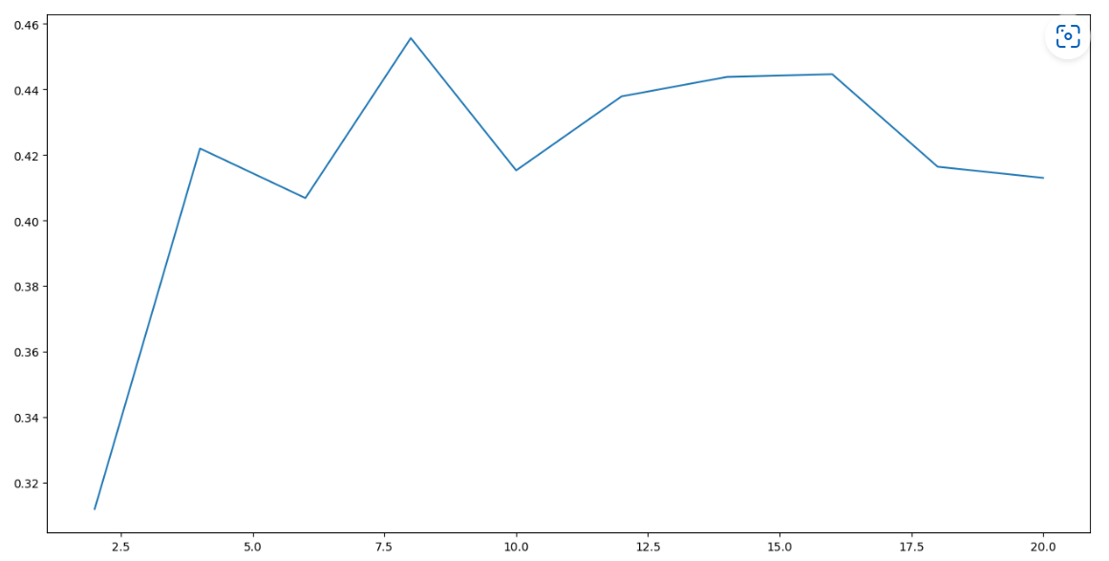
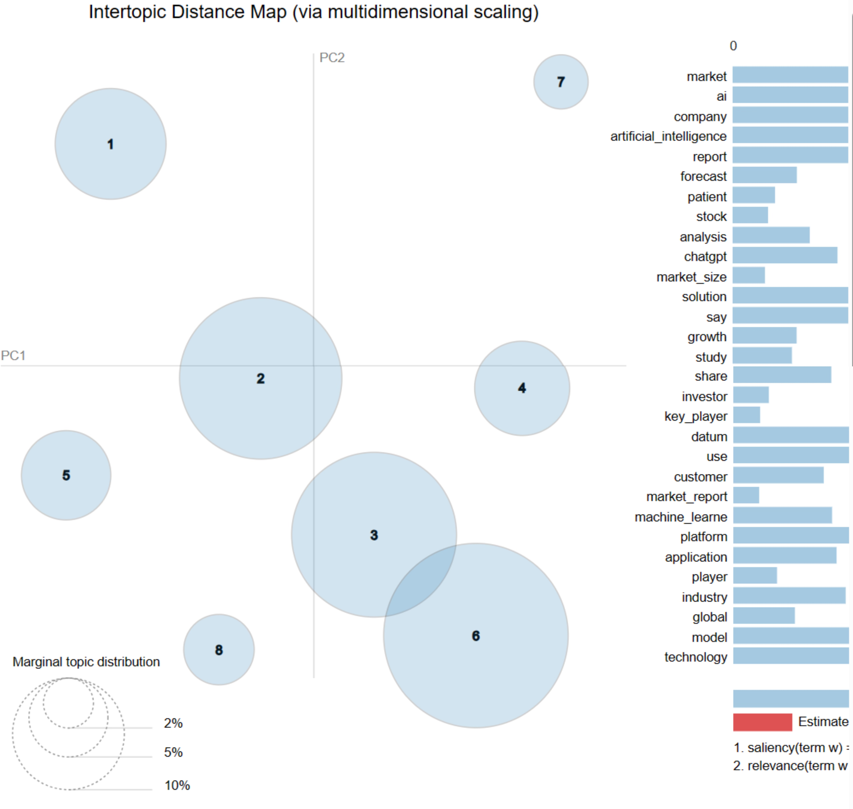
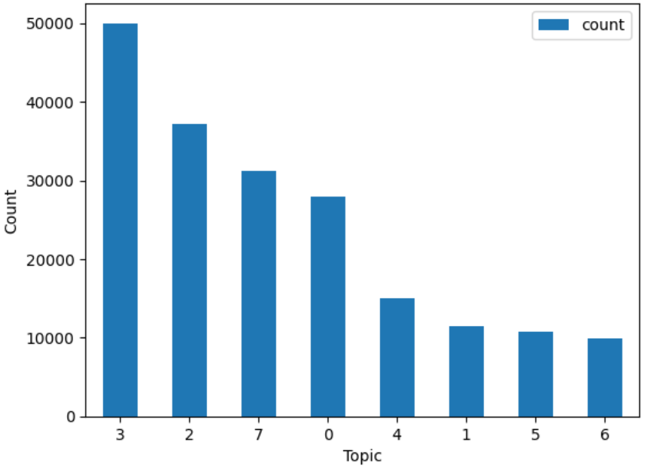
Topic Detection
1ST: Applied LDA using the genism package to find out the best choice of topic numbers: 8, with the highest coherence score: 0.455689. (Figure 2)
Figure 1 shows very few overlap.
K-train Topics
(highest count → lowest)
8 topics
Cloud-Based Business Solutions
Digital Media & Social Networking Analysis
Natural Language Processing & User Experience (ChatGPT)
Human-Centric AI & Learning Systems
Global Market Research
Financial Analysis & Investment Strategies
Healthcare Informatics & Patient-Centric Care
Energy-Efficient Smart Systems & Computer Vision Technologies
Figure2. Coherence Scores For LDA
Figure1:
2nd: Utilized K-train to help better summary and conclude the topics. Figure 3 shows the filtered dataset topic distributions.
Figure3. K-train Topic Distribution

Slide 8
Topic Detection
Successful Factors in AI & DS Initiative
Failed Factors in AI & DS Initiative
Cloud Solutions: The high article count reflects the successful adoption of cloud-based platforms, which offer scalable solutions that drive digital transformation for businesses worldwide.
Customer Experience: AI tools like ChatGPT are revolutionizing customer service by personalizing interactions and improving content delivery through advanced NLP.
Financial Analytics: AI's role in financial analysis is evident in its ability to provide real-time market insights and predictions, enhancing investment strategies for tech-savvy investors.
Security Enhancement: AI's generative models are integral to developing advanced security protocols and risk management systems, safeguarding organizational data.
Patient-Centric Care: AI in healthcare demonstrates success in improving diagnostics and patient care, particularly through medical imaging and data management platforms.
Energy Efficiency: AI's contribution to energy systems focuses on performance optimization, particularly in powering high-performance computing applications.
Educational Advancement: The application of AI in research and education underscores its value in enhancing academic collaboration and learning outcomes.
Public Scrutiny: Concerns over AI tools like ChatGPT in relation to privacy, data handling, and accuracy in search results reflect growing scrutiny of tech giants' AI applications.
Ethical Concerns: Issues with data management and security, alongside the ethical use of AI in business, highlight the need for enhanced privacy frameworks and trust in AI systems.
Economic Sensitivity: The focus on market and stock-related content indicates apprehension about AI's predictive reliability and its potential impact on investment strategies during economic fluctuations.
Algorithmic Trading Uncertainty: Concerns stem from the unpredictable nature of AI in stock trading, where even sophisticated machine learning models can misjudge market dynamics, posing financial risks.
Legal Constraints: Compliance demand and legal frameworks restrict AI's application and innovation potential across industries.
Misinformation in Digital Media: AI-driven content generation tools can inadvertently contribute to the spread of misinformation or fail to adequately filter and verify the vast amount of data on social media platforms.

Slide 9
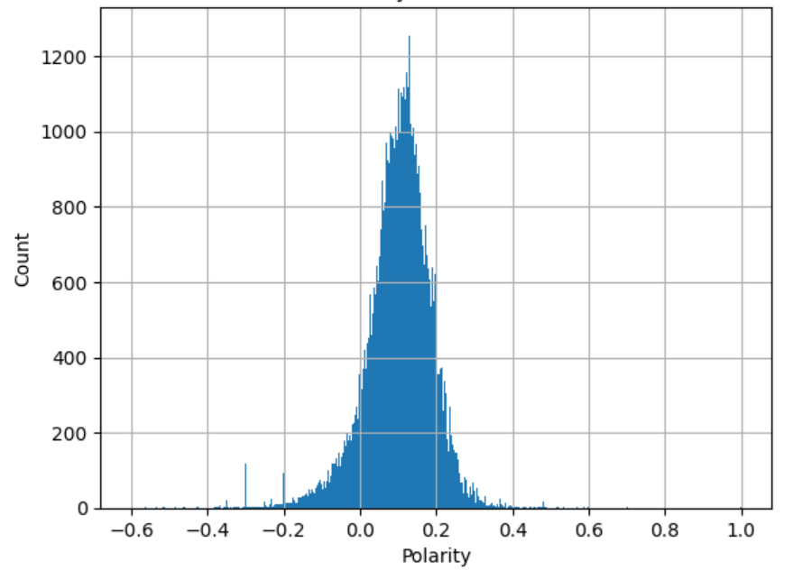
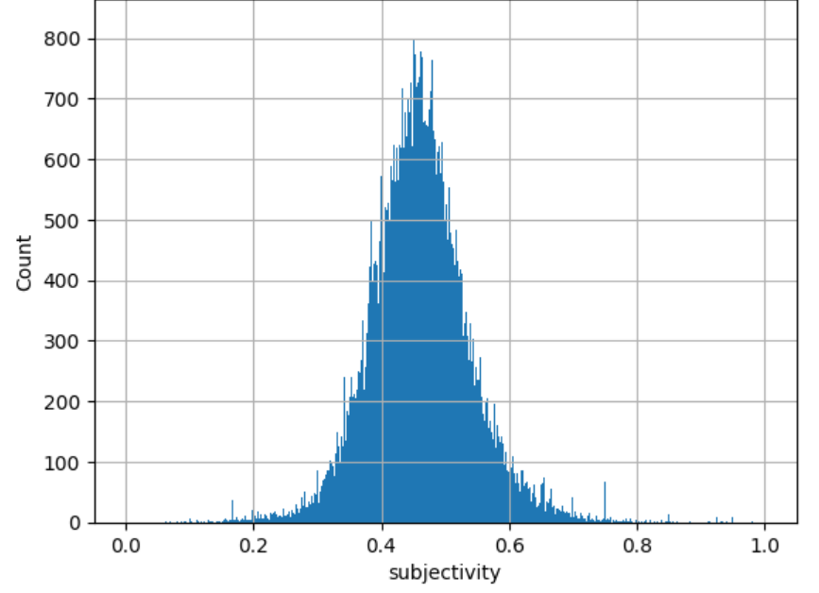
Sentiment Analysis
The analysis of the dataset reveals a predominance of neutral sentiment in the articles, a reflection of the articles standard to maintain objectivity regarding emergent AI technologies. Additionally, the data shows a lot higher incidence of positive over negative sentiment, indicating an overall favorable perspective on AI. This trend underscores a prevalent optimism and receptivity towards AI advancements in the discourse captured by the dataset.
Table1. Aggregated Sentiment Table
Methodology:
TextBlob:
TextBlob is employed to compute polarity scores, which help gauge the overall sentiment of the text, and subjectivity scores, which indicates whether the text expresses personal opinions, for each news article.
Hugging Face Transformer with Batch Processing:
A pretrained model for detailed sentiment classification is used. The selected model is a fine-tuned of distilroberta-base on the financial_phrasebank dataset. To enhance efficiency, especially for longer articles, I’ve implemented a batch processing approach. This method splits texts into manageable segments and processes multiple segments in parallel, significantly accelerating the sentiment analysis while maintaining accuracy.
Advantages:
Depth and Precision: Combination of TextBlob and Transformers ensures a detailed sentiment analysis.
Efficient Text Segmentation: Effective handling of long articles.
Balanced Insight: Offers both quantitative scores and qualitative sentiment labels.
Scalable Approach: Suitable for large datasets.
Results:
I have evaluated the performance based on human judgement. After checking 75 random samples of the articles and made labels on it, 63 of articles are correctly labeled by this combined method (84%).
Sentiment | Articles
Positive | 34668
Negative | 2574
Neural | 83210
Results of TextBlob + Transformer
Results of TextBlob
Figure4. Polarity Distribution
Figure5. Subjectivity Distribution
Notes:
Polarity is a float within the range [-1.0, 1.0], where -1.0 is very negative, 1.0 is very positive, and 0.0 is neutral.
Subjectivity is a float within the range [0.0, 1.0], where 0.0 is very objective and 1.0 is very subjective. The subjectivity score indicates whether the text expresses personal opinions, emotions, or judgments

Slide 10
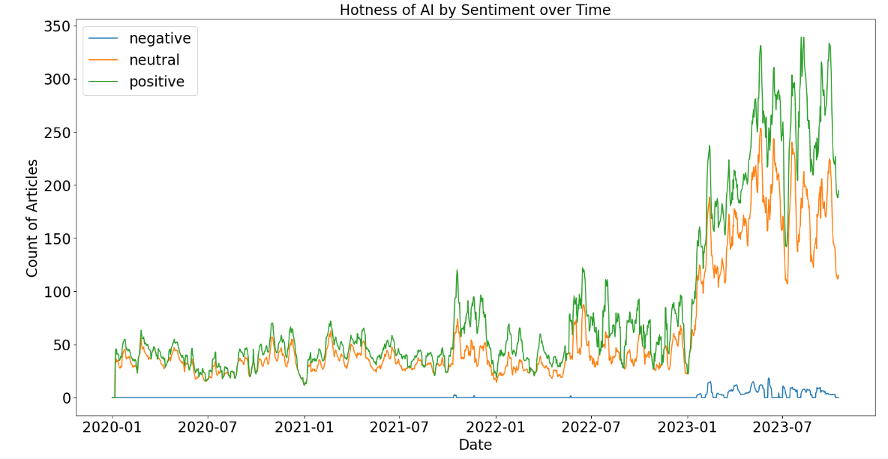
Sentiment Analysis Over Time
Figure 6:
The graph delineates a distinct trough and several peaks in the distribution of positive articles. Notably, there was a marked decline in early 2021, which could be correlated with the incident where Google dismissed Margaret Mitchell, the co-leader of its ethical AI team, following her automated examination of emails to seek out evidence of discrimination against her colleague, Timnit Gebru.
The graph illustrates several notable peaks in positive sentiment, which aligns with the launch of significant AI innovations and strategic partnerships within the industry. The upswing in positive sentiment, particularly from January 2023, may be attributed to the release of ChatGPT 3.5 in November 2022. This version of ChatGPT appears to have garnered substantial public attention and engagement by January 2023, reflecting its impact on public discourse around AI. Subsequently, the sustained high volume of positive articles post-January 2023 suggests a continued and widespread discussion in the media about ChatGPT's capabilities and applications
The consistent predominance of positive articles over negative ones in the dataset suggests an overarching trend of optimism and favorable sentiment toward artificial intelligence. This pattern underscores a general public confidence in the potential and benefits of AI technologies.

Slide 11
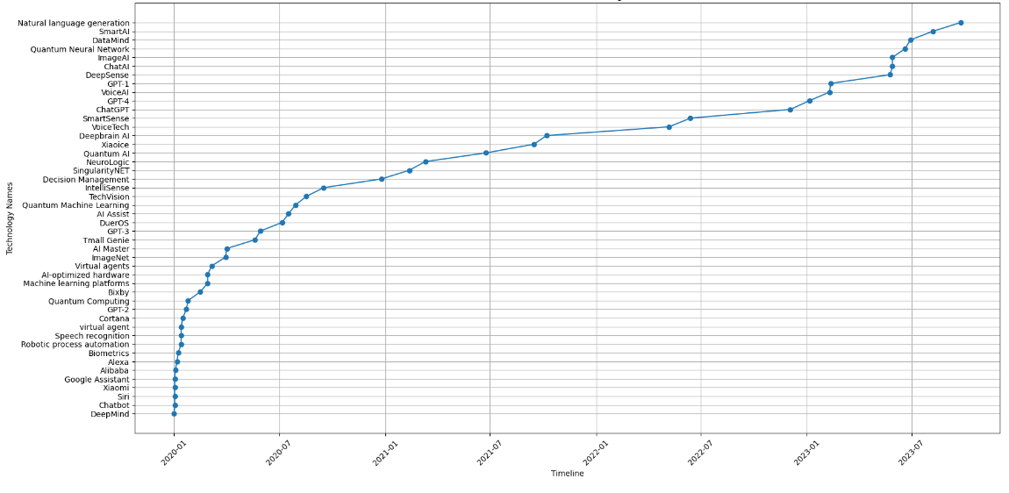
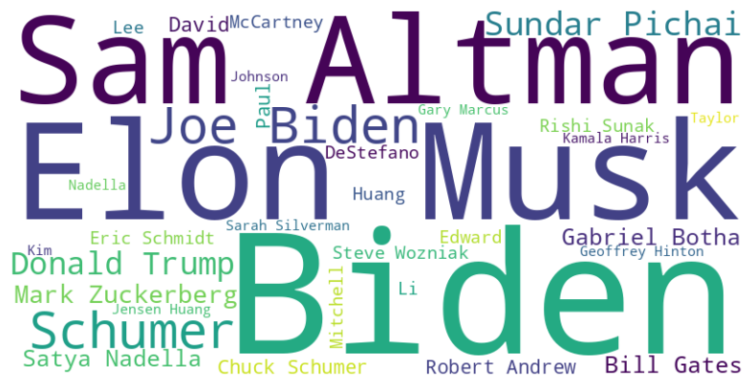
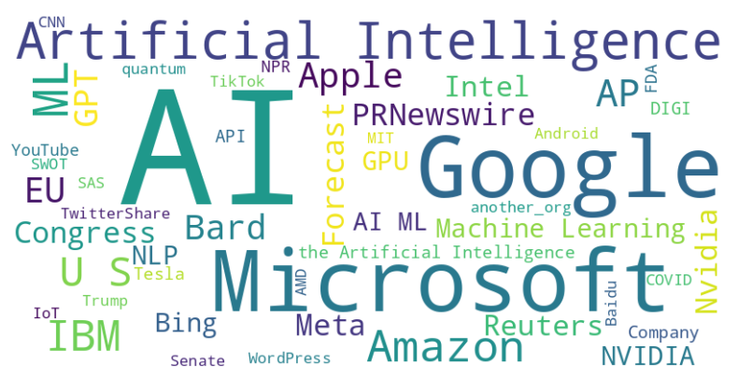
Entity Identification
Figure7: Timeline of New Technology Names
Figure 8: Word cloud for top frequently occurred people
The word clouds generated from the dataset prominently feature key figures and organizations within the AI discourse. Notably, Elon Musk and Sam Altman are frequently mentioned, aligning with their leadership roles at major tech entities such as Tesla and OpenAI. Additionally, the presence of Joe Biden's name suggests a focus on U.S. political strategies concerning AI development. In terms of organizations, tech giants such as Google, Microsoft, and Amazon dominate the conversation, reflecting their significant contributions to AI innovation. I also made a timeline for the introduction of emerging technologies and AI solutions, and ChatGPT, GPT-4, and Alexa are among the most discussed, indicative of their impact on the evolution of data science and its applications.
Figure 9: Word cloud for top frequently occurred organizations

Slide 12
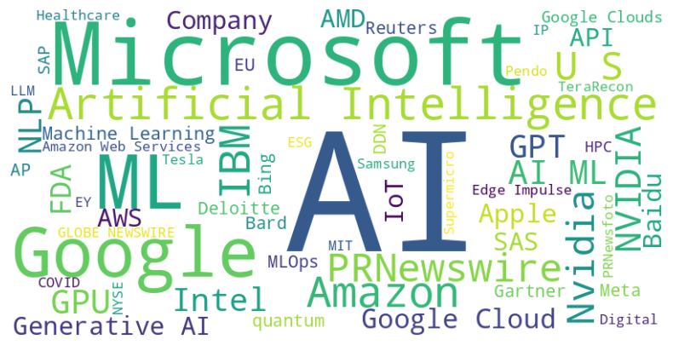
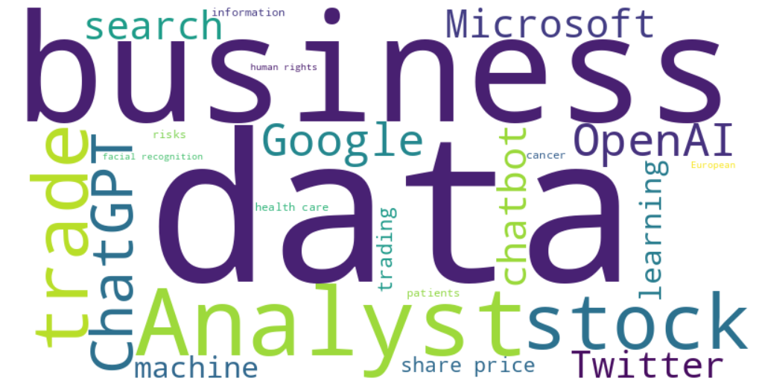
Targeted Sentiment Identification
The left figure, focusing on positive sentiments, reveals that Microsoft and Google are among the most frequently mentioned organizations in favorable discussions about AI, underscoring their significant role in the AI domain. Importantly, the data also highlights prominent mentions of companies across diverse sectors, evidencing AI's cross-industry impact. In healthcare, organizations like the FDA and Roche are noted for their integration of AI in advancing medical research and diagnostics. JPMorgan represents the financial sector's adoption of AI for enhancing service delivery and risk management. Media companies such as Netflix are recognized for leveraging AI in content personalization and viewer engagement, while educational platforms like Coursera utilize AI to tailor and improve learning experiences. These findings align with the multifaceted contributions of AI, driving innovations and efficiencies across various industries.
Figure 10: Word cloud for top frequently occurred positive organizations
The right-hand word cloud visualizes the negative sentiments from our dataset, with k-train topic modeling pinpointing terms frequently associated with AI challenges or setbacks. For example, since financial markets has unpredictability, human expertise on the stocks and markets may sound more reasonable. Additionally, the word cloud indicates potential issues within education, hinting at ethical concerns such as academic integrity in the context of AI tools like those developed by OpenAI. And AI applications in healthcare are diverse, yet certification courses, executive training, and personalized online learning often necessitate human expertise to navigate complex medical scenarios.
Figure 11: Word cloud for top frequently occurred negative entity related topics

Slide 13
Actionable Recommendations
Technology:
To harness AI's potential in improving operations, technology companies should invest in cloud-AI integrations, focusing on creating smart, adaptive solutions for operational optimization and customer experience enhancement, as seen in the supply chain and maintenance sectors. Furthermore, by forming strategic partnerships, they can integrate NLP advancements like ChatGPT to refine user interfaces and assist in technical support, ensuring a seamless user experience.
Finance:
Financial institutions should capitalize on AI for market analytics, using sophisticated algorithms to analyze trends and automate trading. They must also invest in robust data validation processes to avoid erroneous predictions and establish protocols to mitigate risks during market volatility, ensuring reliable financial forecasts and decisions. However, it is noticeable that since financial market has unpredictability, which AI may not have reached without human expertise.
Healthcare:
Healthcare organizations should continue to invest in AI for enhancing diagnostics and patient management, with an emphasis on rigorous testing and ethical AI deployment to safeguard patient privacy. Additionally, given the risks of data breaches, the development of secure AI infrastructures that comply with healthcare regulations like HIPAA is essential. But doctors and nurses cannot be replaced by AI since AI cannot ensure the accuracy and expertise on surgeries while facing patients.
Digital Media:
Media companies can utilize AI to curate content and assist in journalistic tasks, improving productivity and content relevance. However, they should implement strong verification filters to combat the spread of misinformation and invest in AI tools that support the creation of original content while respecting ethical standards and copyright laws.
Education:
Educational institutions should leverage NLP tools like ChatGPT to aid learning and administrative tasks. It's crucial to provide comprehensive training on the ethical use of AI, develop clear guidelines to uphold academic integrity, and use AI as a complement to traditional learning and assessment methods, not a replacement.

Slide 14
Thank you!
Q&A?

